Slide 1
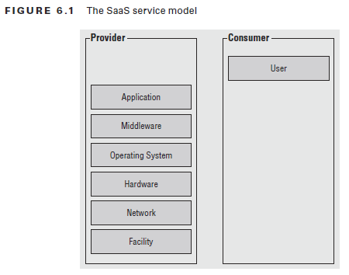
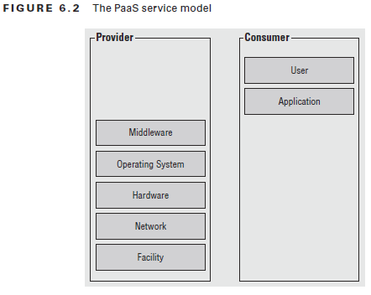
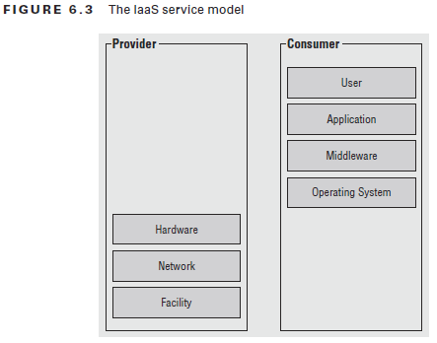
SaaS, Paas, Iaas structures.
Paas let you bind your application code to libraries that give access to the infrastructure your application needs
Iaas provide raw compute, storage, and network, organized in ways that are familiar from physical data centers

Slide 2
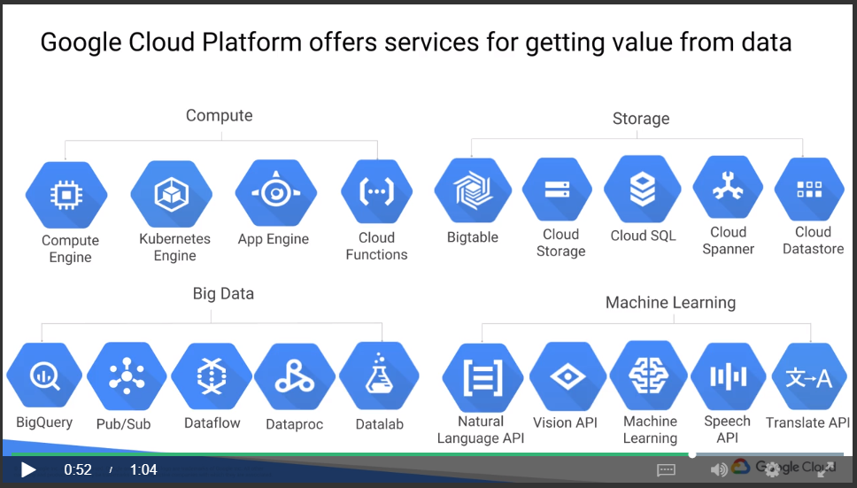
Services from Google Cloud Platform (GCP):
GCP has 4 big components: Compute, Storage, Big Data and Machine Learning
The sub categories are shown as follow.
* from Coursera

Slide 3
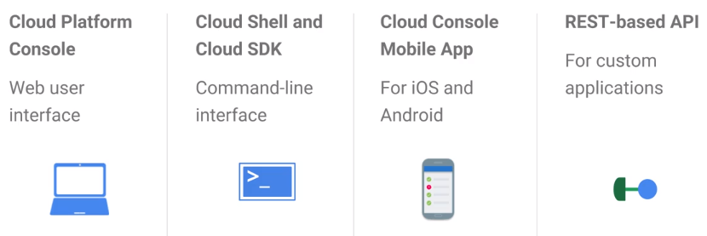
GCP中，必须有一个Organization code
所有的GCP的resource都必须属于一个project，以便管理
IAM中，有primitive role和predefined role
Primitive role包括owner/editor/viewer；这个比较广，在人多的情况下需要细分；不能改变；Primitive role是给project的
Predefined role细分了Who can do WHAT；predefined role是给project下的user的
Sevice account does:
Authenticate between GCP services
A way to restrict the actions a resource (e.g., VMs) can perform
A way to allow users to act with service account permissions
Key generation and rotation when used with App Engine and Compute Engine
About Compute Engines (VMs):
Preemptible VMs are highly affordable, short-lived compute instances suitable for batch jobs and fault-tolerant workloads.

Slide 4
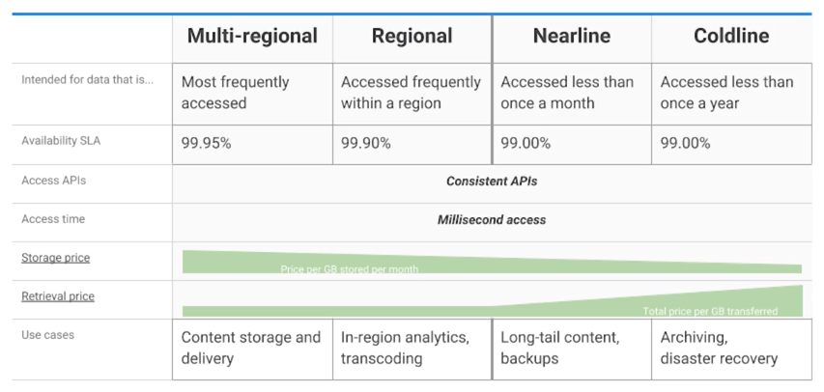
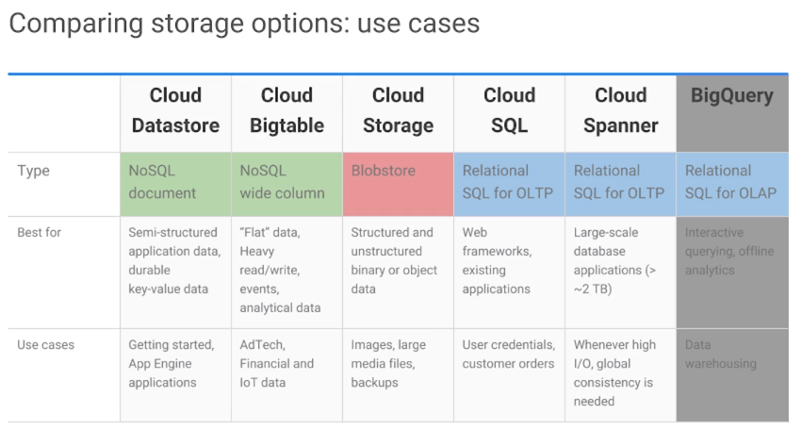
For Infrequently accessed data (1 per month)
For Infrequently accessed data (1 per year)
Storage:
Cloud storage
No sql
Buckets, can control ACL (Access Control Lists) for each buckets
Can turn on/off overwrite (just like git, can track history)
这个storage就感觉和Google Drive相似，可直接存文件
有4个种类，见右图
is often the ingestion point for data being moved into the cloud, and is frequently the long-term storage location for data
Good for immutable (一成不变的) binary objects
Cloud sql
mySQL and PostgreSQL as service
Cloud spanner
Same as cloud sql
Good for a relational database with SQL queries and horizontal scalability
Cloud data store
To store object data from app engine
Good for structured objects with transactions and SQL-like queries
Google big table
Is a managed NoSQL
Good for structured objects, with lookup based on a single key
以上４種類のStorageのUsercaseは、右：

Slide 5
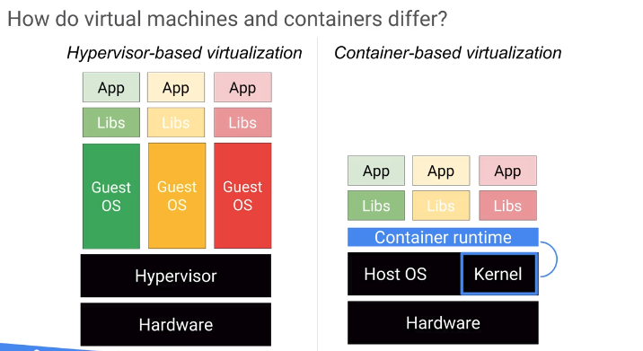
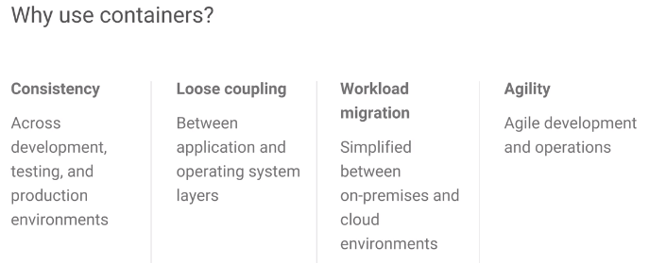
Container:
A substitute for VMs. (两者都是在同一Hardware上实现isolated虚拟环境的方法)
Kubernetes Engine is used to manage the containers.
Require low overhead.
Vm和container的不同见右图
比VM的启动速度更快，消耗资源更少
Kubernetes:
Use Pod, which is a group of containers, in deployment. (我把我的subsystem装到一个container里，别人把别人的subsystem装到一个container里，然后2个container装到一个pod里)
Kubernetes cluster nodes是VM instances
Compute Engine and Kubernetes Engine are used to provide compute infrastructure for applications.
我的理解是Compute Engine (a.k.a VMs)和Kubernetes Engine (a.k.a Containers)是实现同一个目的的两个工具
每个VM都有自己的OS；
所以VM的boot会slow，
并且resource heavy
Container是基于OS的每一个process(并且其memory space)都是isolated
概括一下就是，Container只提供app所需要的最少libs，
所以app deploy会变得非常快

Slide 6
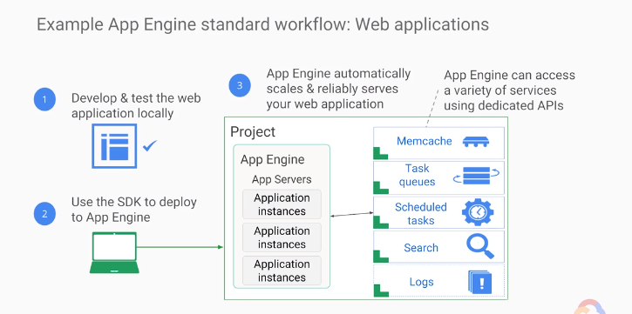
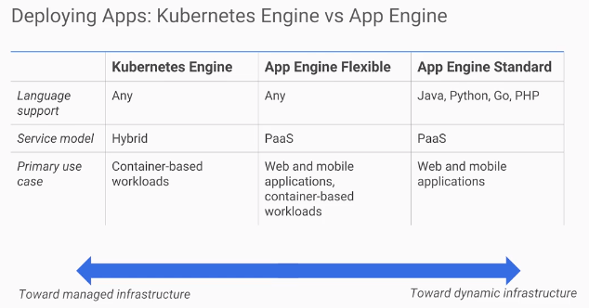
App Engine:
Unlike Compute Engine and Kubernetes Engine, which focus on Infrastructure, App Engine focuses on Code
当deploy app时，只需要给app engine code，然后app engine搞定其他，如load balancing, logging等
有两个environments，standard和flexible
Standard提供runtime，针对java，go，php等语言(没C/C++)
Standard提供sandbox
Flexible和container一起，app在container里，container在VM上
App engine的test和deploy方法见右图
Kubernetes和App Engine的不同，我的理解是，Kubernetes需要自己config infra和code，但app，特别是standard只需要关心code
Cloud Endpoints:
和API有关，当你想知道谁，在什么时候，怎么用你提供的API，用了几次的时候，用这个
专用语API logging and monitoring
Apigee Edge:
A platform for making APIs available to your customers and partners.
一般用于business analytics and billing

Slide 7
Cloud Source Repository:
Customers no need to maintain git instance themselves
Is a cloud version of Git; can be managed by IAM
Cloud Function:
Is a javascript that respond to events without a server or runtime
Define events as triggers; then attach javascripts to those triggers
Trigger example: some new image is uploaded
Deployment Manager:
needs a template to define what the environment should look like
Is an infrastructure management system for GCP resources.
Stackdriver:
Is a tool for monitoring, logging and diagnostics.
Core components: monitoring, logging, trace, error reporting, debugger.
似乎是第三方app，也可以监视AWS cloud
Logging机能允许用户define metrics on logs

Slide 8
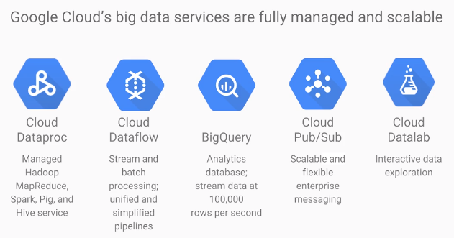
BigQuery
Used for SQL queries on a massive dataset
Cloud Pub/Sub
Is a messaging service
Publisher/subscriber model
Good for Internet of Things app
Cloud Datalab
Aka. Python Jupiter web notebook
Apache Hadoop
Based on MapReduce programming model
Dataproc
Is a way to ran Hadoop, Spark, Hive and Pig on GCP
Charged by minutes
Next step is to use Mlib (apache machine learning lib)
Dataflow
data shows up in real time or it's of unpredictable size or rate
Use pipeline

Slide 9
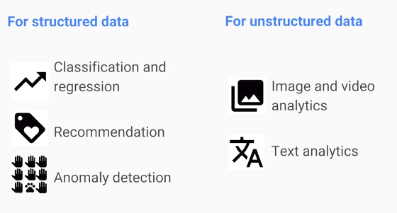
Cloud Machine Learning Platform:
For structured data
For unstructured data
APIs:
Cloud Vision API
Cloud Speech API
Natural Language API
Cloud Video Intelligence API

Slide 10
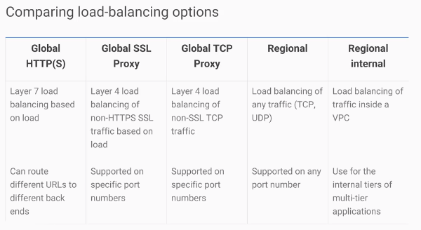
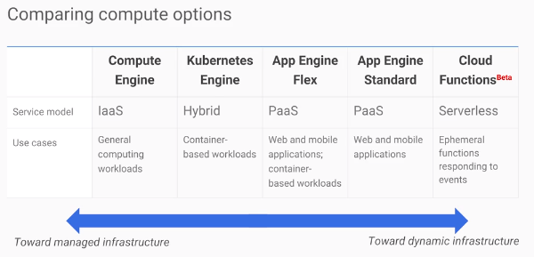
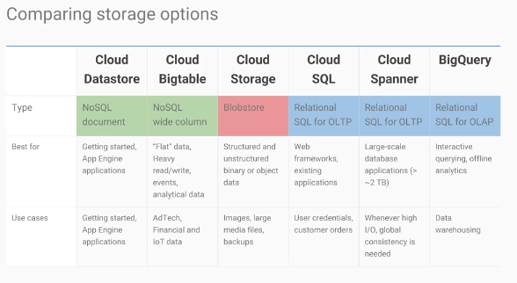
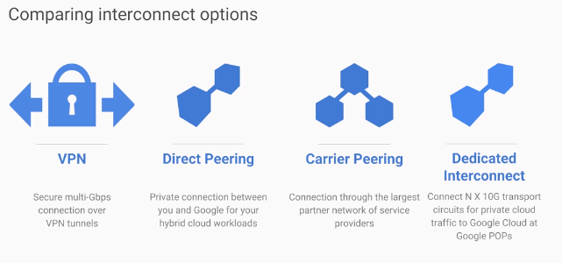
Summary
以下是GCP主要提供的各种功能
最简单的接VPN进Virtual Personal Cloud的方法是cloud router

Slide 11
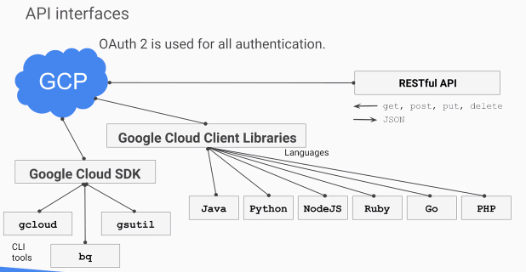
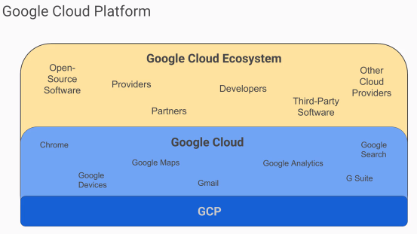
What is GCP
2 interfaces GCP provides:
Cloud shell (a.k.a, a terminal)
Cloud console (a.k.a, the browser UI interface)

Slide 12
YAML is a templating language. YAML files are used for configuration of many Google Cloud Platform services

